Slide 1
HOTEl BOOKING ANALYSIS
Abdulrahman Sherif

Slide 2
Introduction
Overview : Eda process for hotel reservations to understand seasonal trends, pricing patterns and customers behaviour
Objective : get insights about the factors that affect bookings and cancellations in hotel

Slide 3
EDA PROCESS
1- Data preprocessing :
libraries used ( pandas , matplotlib , seaborn)
Check missing values and duplicates
2- Expolartaroy analysis :
statistics of numerical columns
Distrubtion of categorical columns
Impact of each column according to other
3- insights visualizations :
Booking trends
Pricing patterns

Slide 4
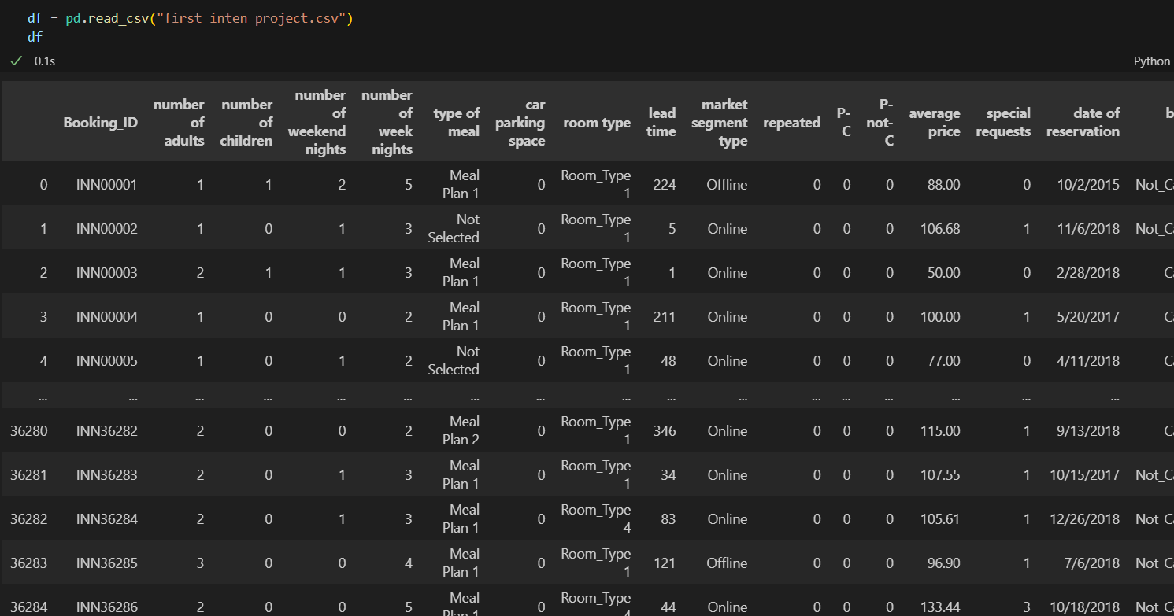
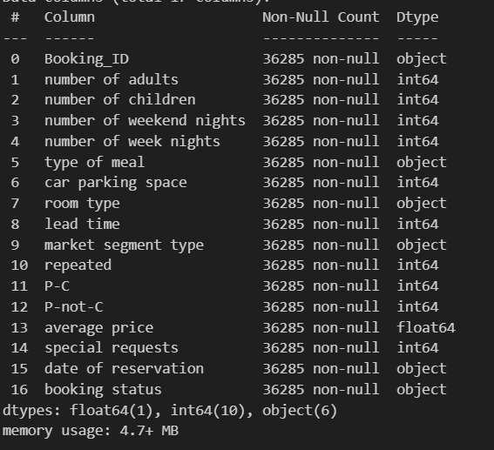
Read data & preprocessing

Slide 5
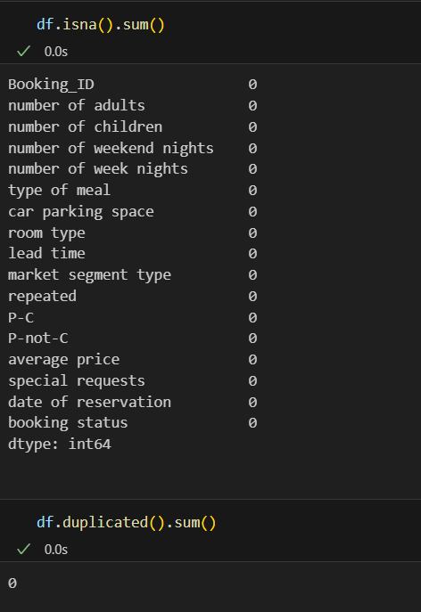
Check missing values & duplicates

Slide 6
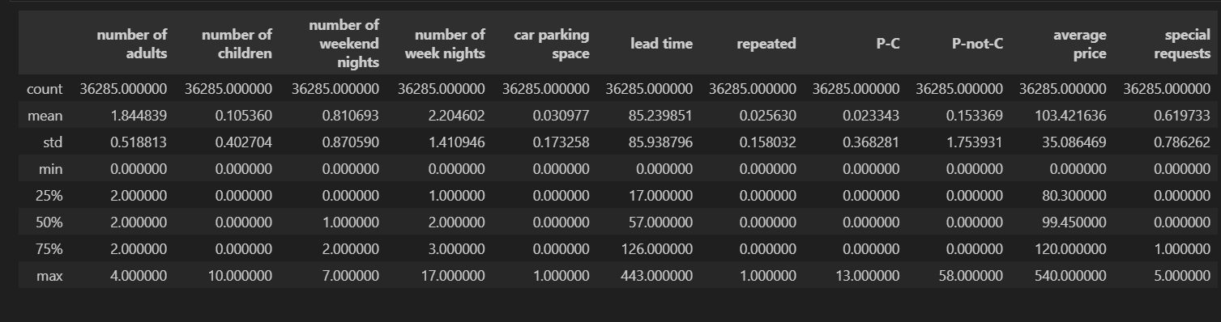
Statistical summary of numerical data

Slide 7
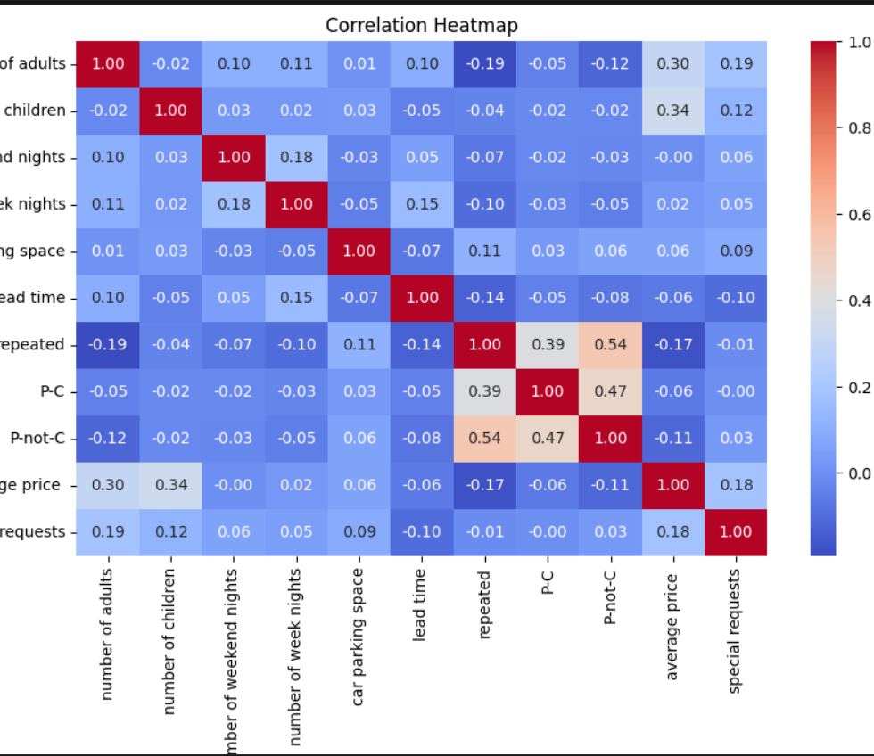
Correlation heatmap

Slide 8
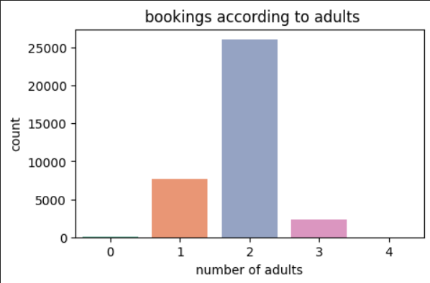
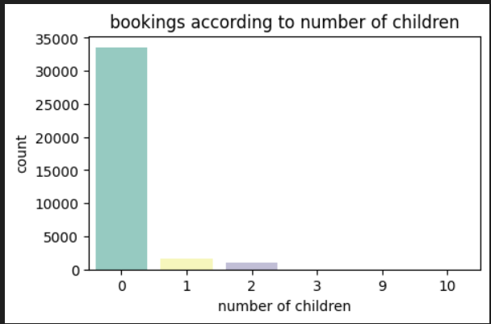
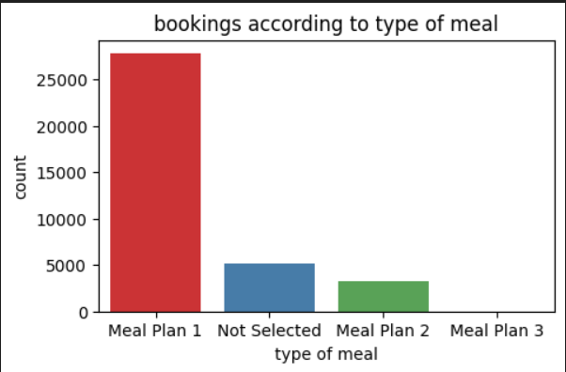
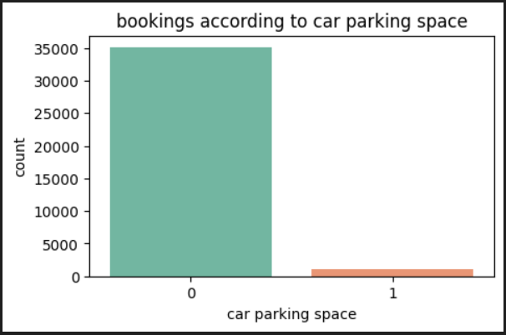
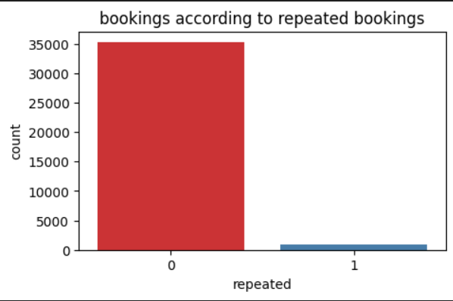
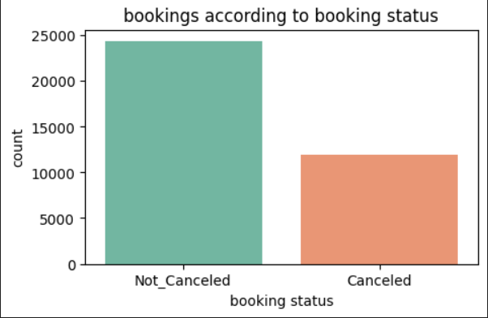
Distrbution of categorical data

Slide 9
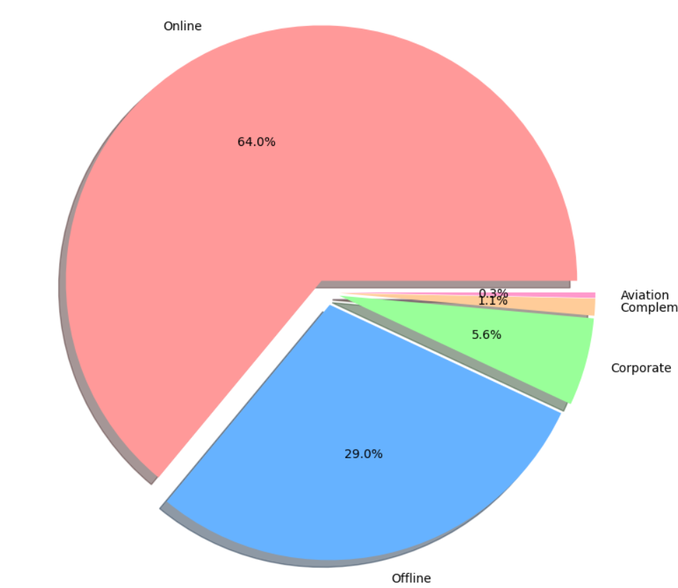
Most market segment used

Slide 10
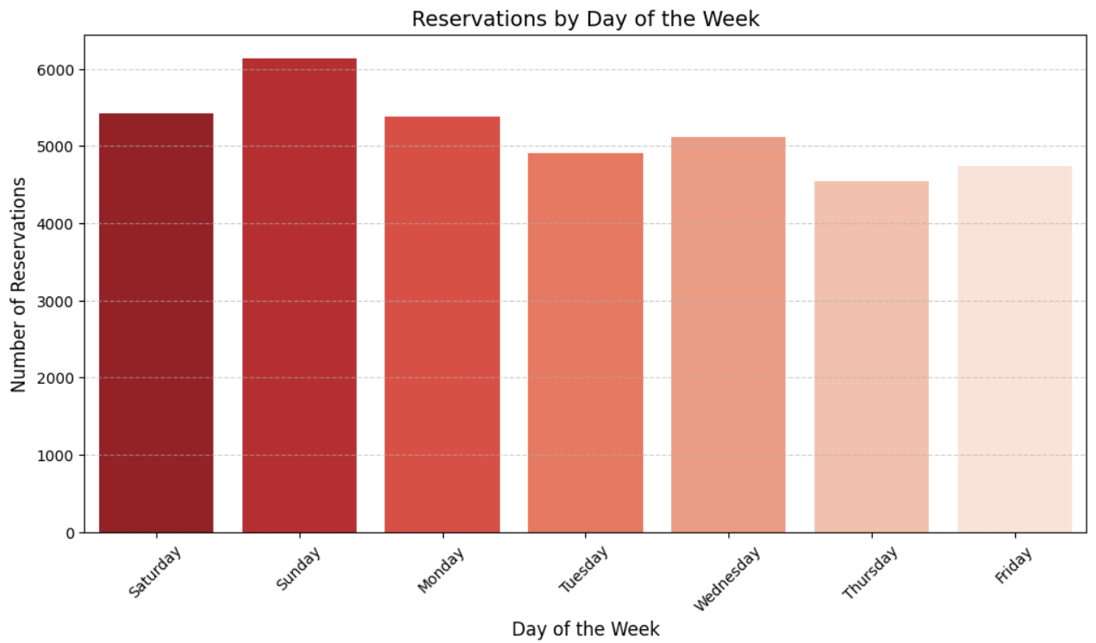
The day that has the most bookings

Slide 11
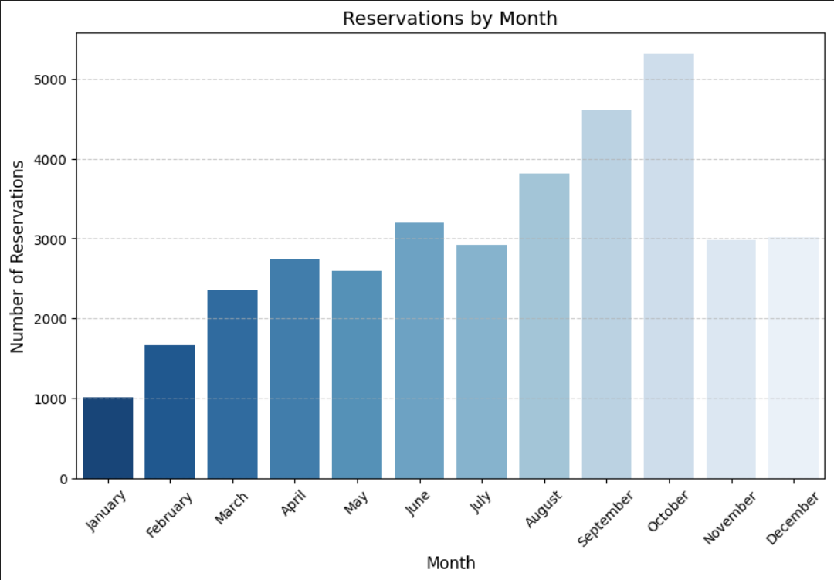
The month that have the most bookings

Slide 12
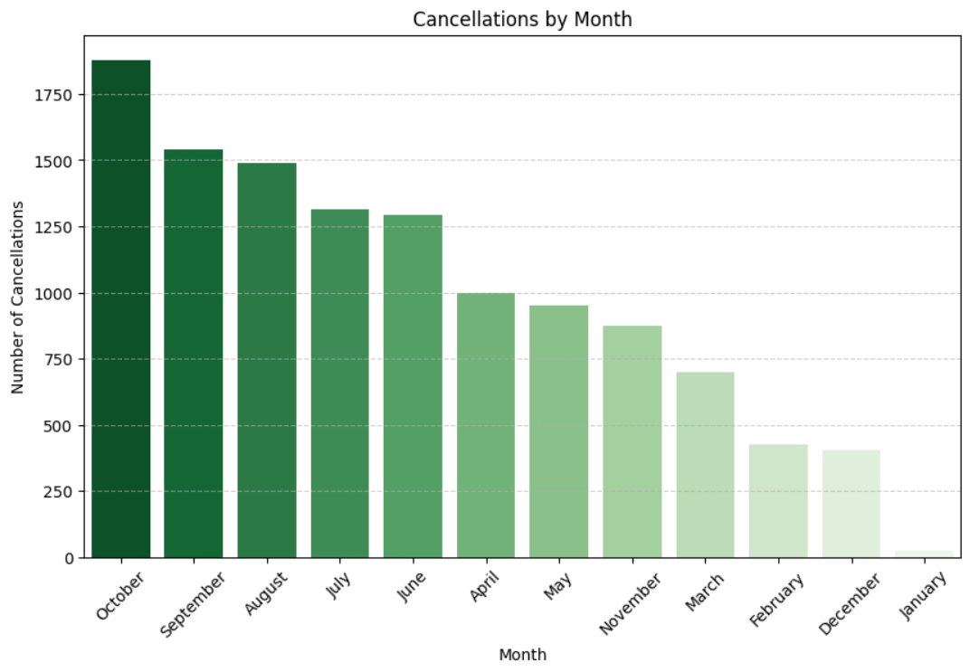
The month that has the most cancellations

Slide 13
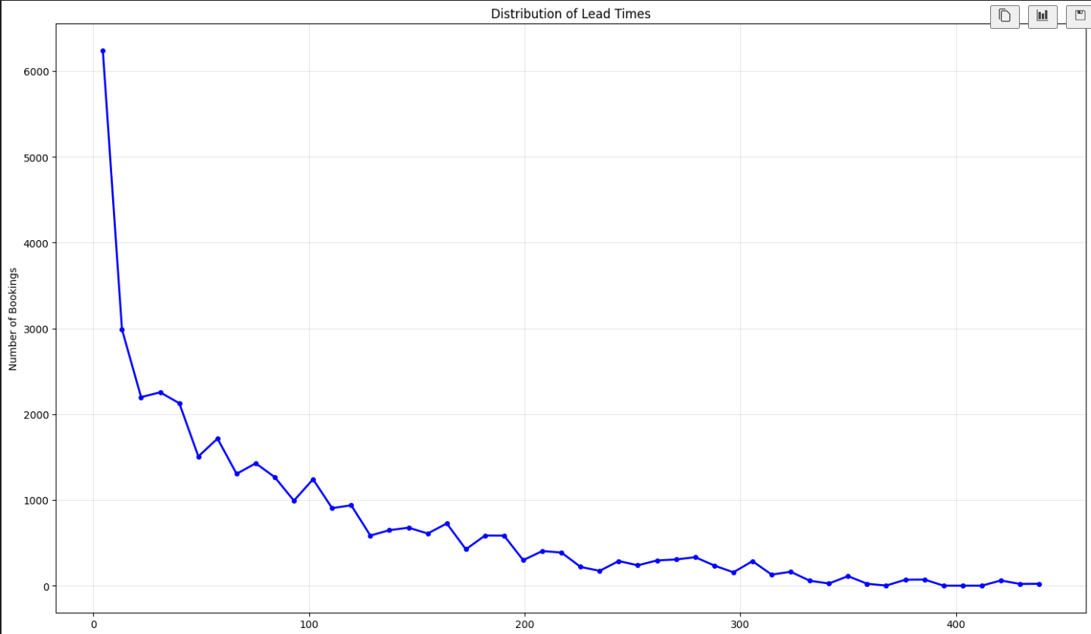
Distrubtion of lead time

Slide 14
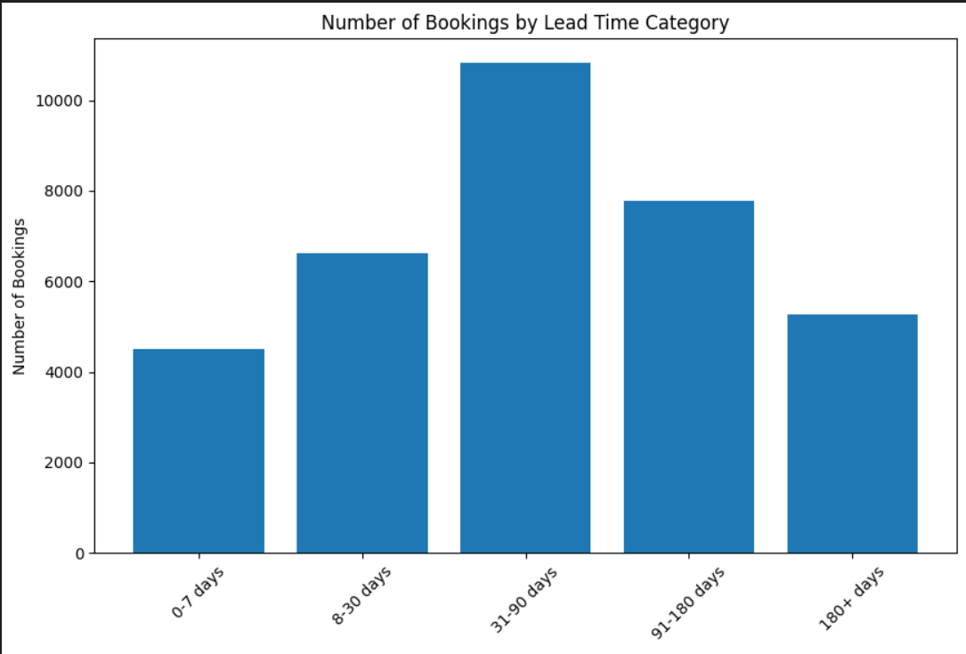
Number of bookings according to Lead time category

Slide 15
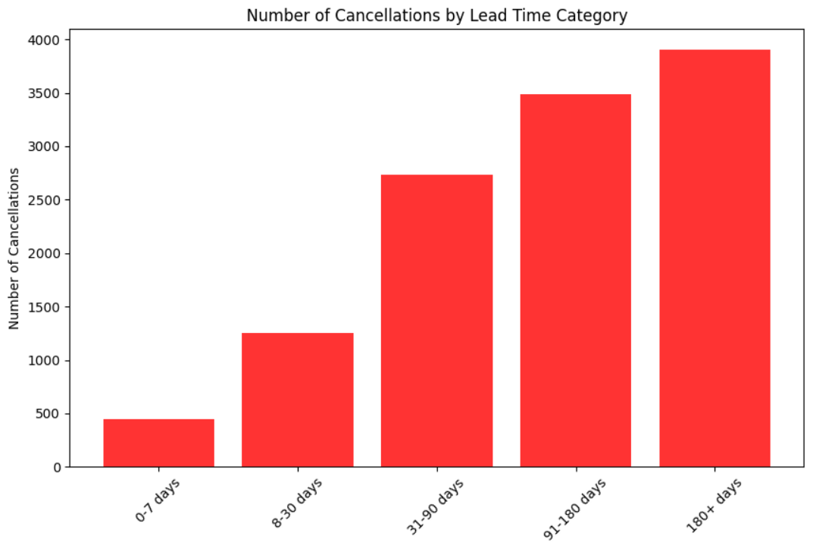
Number of cancellations according to time lead category

Slide 16
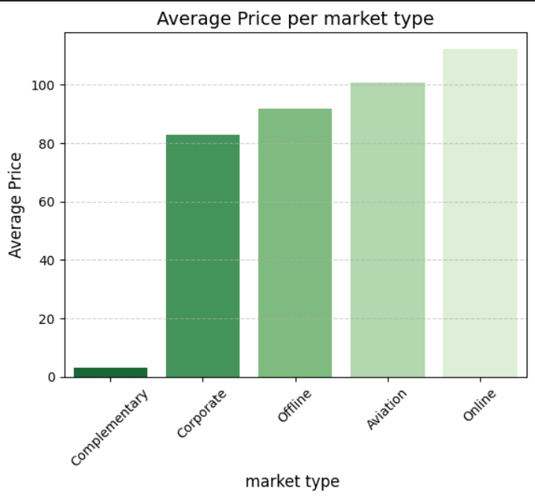
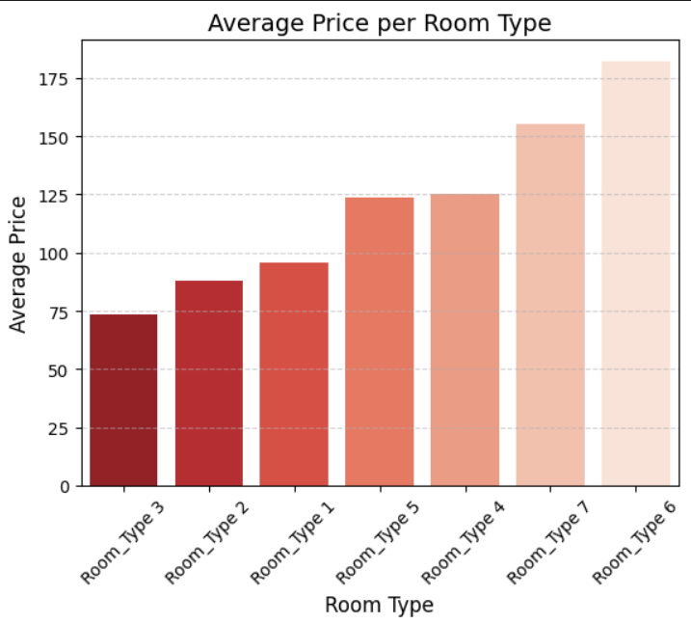
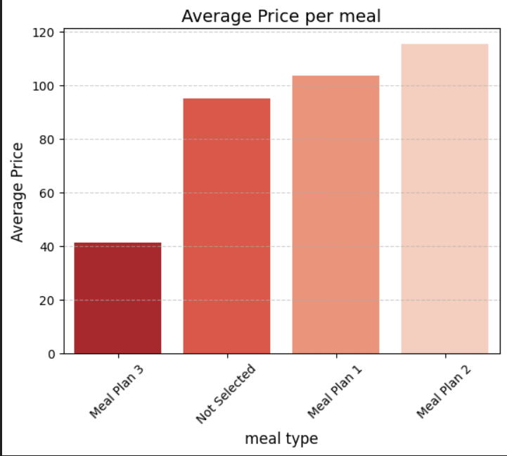
Average price according to other features

Slide 17
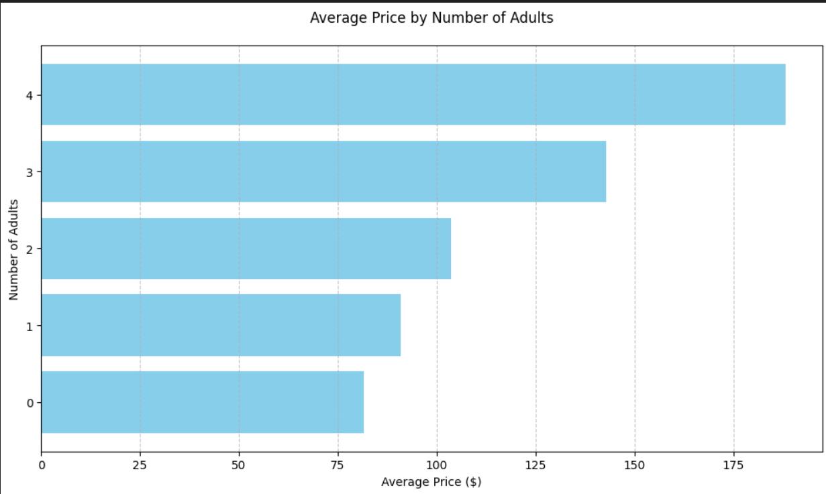
Average price according to number of adults

Slide 18
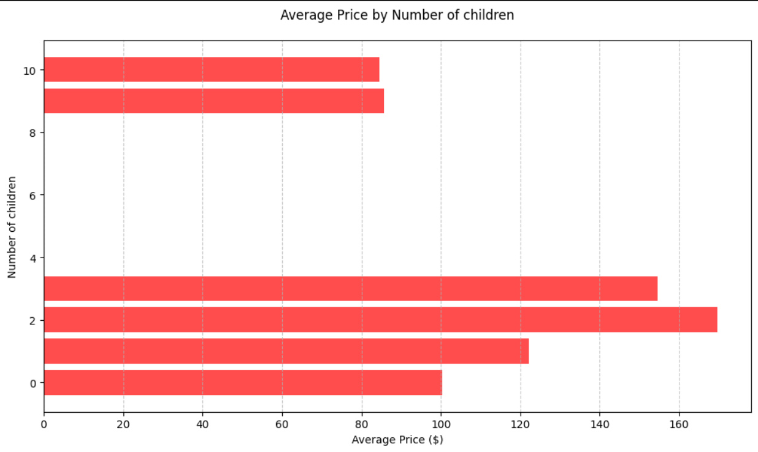
Average price according to number of children

Slide 19
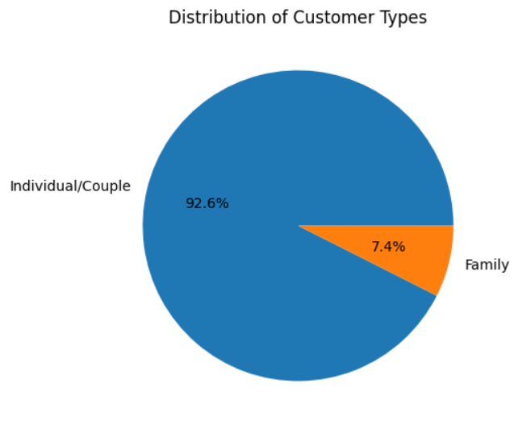
Individual vs family bookings

Slide 20
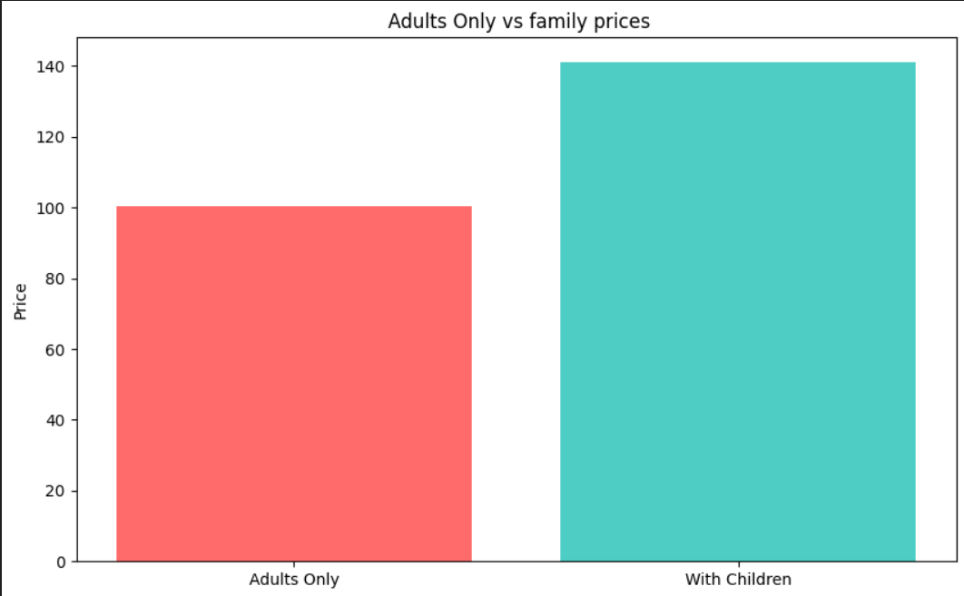
Adults only prices vs family prices

Slide 21
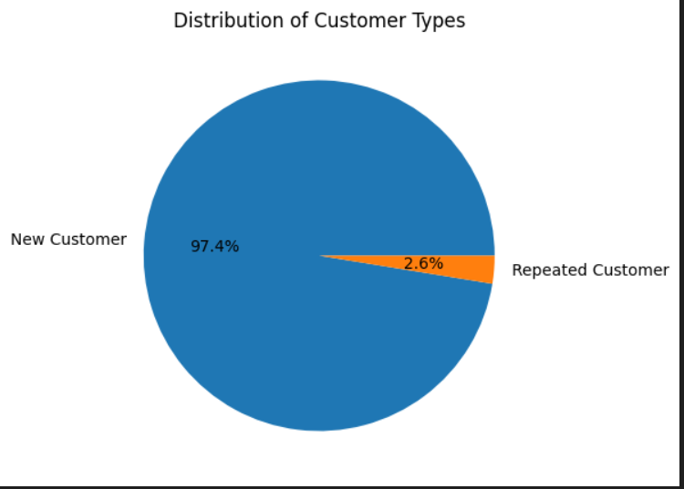
Customer type distrubtion

Slide 22
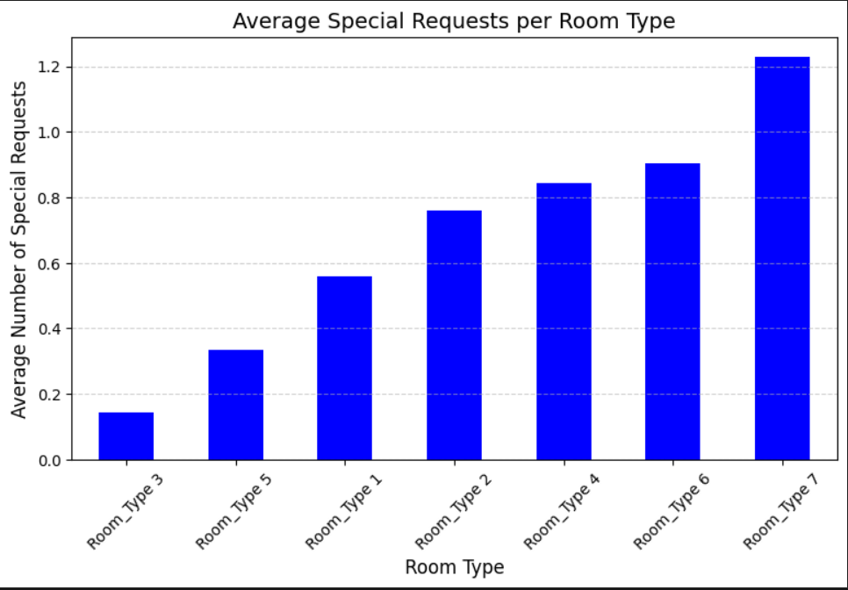
Room type that has the most special requests

Slide 23
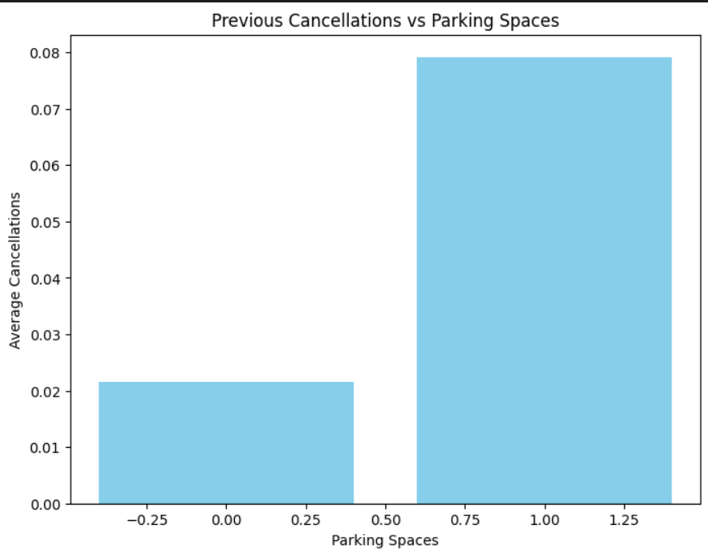
Car parking space effect on previous cancellations

Slide 24
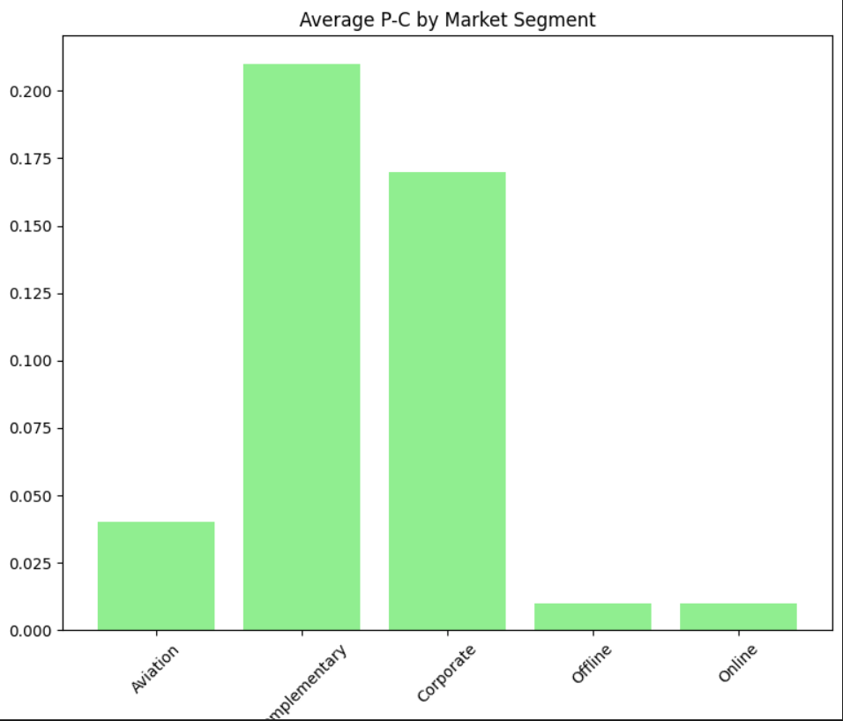
Market segment type that has the most previous cancellations rate

Slide 25
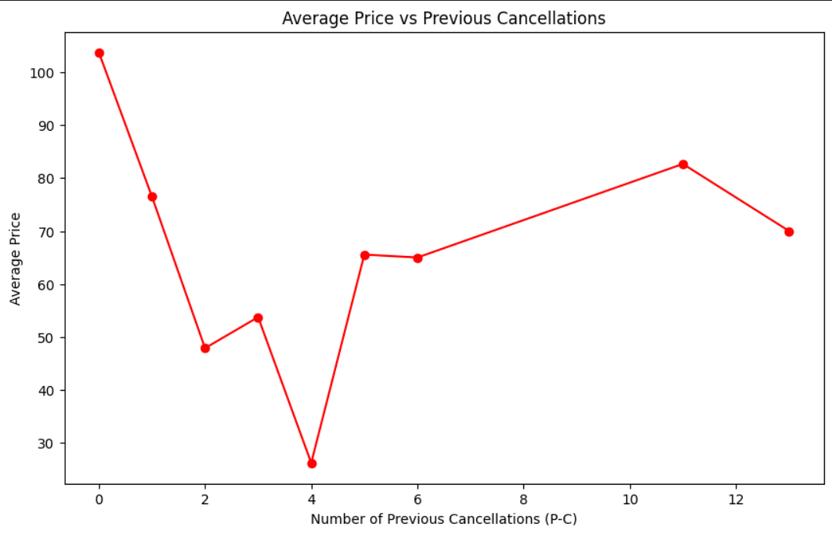
Average price effect on the previous cancellations

Slide 26
Thank you

